Slide 1
The analytic hierarchy process (AHP)
Xu, X. 2025/3/4

Slide 2

Background
To Tsinghua or Peking University? Publishing Nature or Science?
Atmosphere of learning
Campus view
Proportion of handsome men
Job prospects

Slide 3
Background
 | Weight | Tsinghua | Peking
Atmosphere of learning | 0.1 | 0.7 | 0.3
Campus view | 0.1 | 0.5 | 0.5
Proportion of handsome men | 0.7 | 0.7 | 0.7
Job prospects | 0.1 | 0.25 | 0.75

Slide 4
Essence
AHP is a comprehensive evaluation method for system analysis and decision-making.
The main feature of AHP is that by establishing a hierarchical structure, human judgment is transformed into a comparison of the importance of a number of factors.

Slide 5
Inspirational example
Xiao Ming wants to travel. He initially selected Nantong, Suzhou and Changsha were selected as the target attractions. Please choose the most suitable scheme for Xiaoming.
What is the goal of our evaluation?
A: Choose the best tourist attractions for Xiao Ming.
What are the options we have to achieve this goal?
A: Three, to Nantong, Suzhou and Changsha.
What are the evaluation criteria or indicators? (By what do we judge good or bad?)
A: The question does not give relevant data support, so we need to confirm.

Slide 6



Procedure
Step 1. Analyze the relationship between the factors in the system and establish a hierarchical structure for the system.
Objective
destination (O)
Criterion
View (C1)
Cost (C2)
Live (C3)
Meal (C4)
Transport (C5)
Plan
SuZhou (P1)
NanTong (P2)
ChangSha (P3)

Slide 7
Procedure
Step 2. A two-by-two comparison is made between elements of the same level with respect to the importance of a criterion in the previous level, and a two-by-two comparison matrix (judgment matrix) is constructed.
Objective
destination (O)
Criterion
View (C1)
Cost (C2)
Live (C3)
Meal (C4)
Transport (C5)
Plan
SuZhou (P1)
NanTong (P2)
ChangSha (P3)

Slide 8
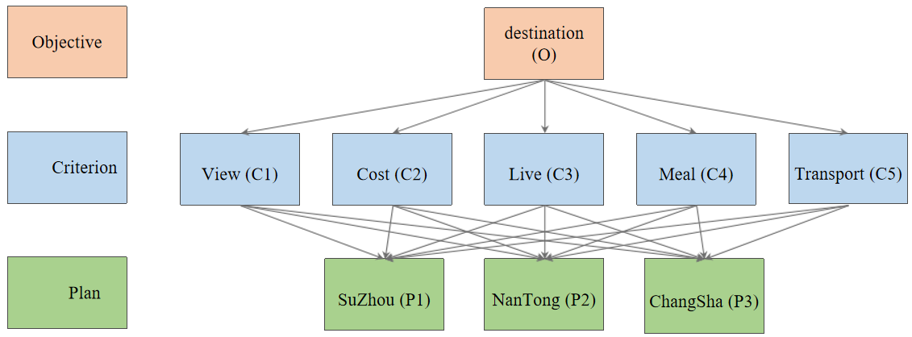
Procedure
O | C1 | C2 | C3 | C4 | C5
C1 | 1 | 1/2 | 4 | 3 | 3
C2 | 2 | 1 | 7 | 5 | 5
C3 | 1/4 | 1/7 | 1 | 1/2 | 1/3
C4 | 1/3 | 1/5 | 2 | 1 | 1
C5 | 1/3 | 1/5 | 3 | 1 | 1
The name of the matrix on the left is: Judgment Matrix O - C.
Tip: Any evaluation class model is subjective:
Ideal: use expert group judgment
Reality: almost always filled in by yourself

Slide 9
Definition——Judgment Matrix
Summarize: we denote the square matrix as A, and the corresponding elements are aij .
(1) aij denotes the significance of the importance of i compared to indicator j.
(2) When i = j, the two indicators are the same, so the equal importance is recorded as 1, which explains that the main diagonal element is 1.
(3) aij > 0 and satisfy aij*aji = 1 (we call the matrix that satisfies this condition a positive inverse matrix)
O | C1 | C2 | C3 | C4 | C5
C1 | 1 | 1/2 | 4 | 3 | 3
C2 | 2 | 1 | 7 | 5 | 5
C3 | 1/4 | 1/7 | 1 | 1/2 | 1/3
C4 | 1/3 | 1/5 | 2 | 1 | 1
C5 | 1/3 | 1/5 | 3 | 1 | 1

Slide 10
Procedure
C1 | P1 | P2 | P3
P1 | 1 | 2 | 4
P2 | 1/2 | 1 | 2
P3 | 1/4 | 1/2 | 1
C2 | P1 | P2 | P3
P1 | 1 | 1/3 | 1/8
P2 | 3 | 1 | 1/3
P3 | 8 | 3 | 1
C3 | P1 | P2 | P3
P1 | 1 | 1 | 3
P2 | 1 | 1 | 3
P3 | 1/3 | 1/3 | 1
C4 | P1 | P2 | P3
P1 | 1 | 3 | 4
P2 | 1/3 | 1 | 1
P3 | 1/4 | 1 | 1
C5 | P1 | P2 | P3
P1 | 1 | 1 | 1/4
P2 | 1 | 1 | 1/4
P3 | 4 | 4 | 1
JM: C1‐P
JM: C2‐P
JM: C3‐P
JM: C4‐P
JM: C5‐P

Slide 11
Procedure
Step 3. Calculate the relative weights of the elements being compared with respect to the criterion from the judgment matrix and perform a consistency test (the weights can only be used if the test is passed).
Three methods are used to calculate the weights: (1) arithmetic mean (2) geometric mean (3) characteristic value method
Note:
(1) the consistency matrix does not need consistency test;
(2) The consistency test should be carried out first, and then calculate the weights after passing the test.

Slide 12
Consistency matrix
O | C1 | C2 | C3 | C4 | C5
C1 | 1 | 1/2 | 4 | 3 | 3
C2 | 2 | 1 | 8 | 6 | 6
C3 | 1/4 | 1/8 | 1 | 3/4 | 3/4
C4 | 1/3 | 1/6 | 4/3 | 1 | 1
C5 | 1/3 | 1/6 | 4/3 | 1 | 1
We call a matrix a positive inverse matrix if each element aij > 0 and satisfies aij*aji = 1. In hierarchical analysis, the judgment matrices we construct are all positive inverse matrices.
If the positive inverse matrix satisfies aij*ajk = aik, then we call it a consistent matrix.
Observe the characteristics of this matrix above: the rows (columns) are multiplicative of each other

Slide 13
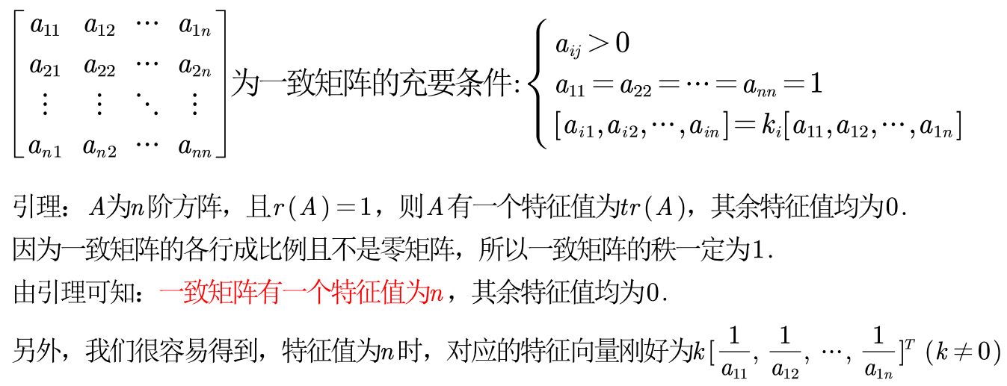
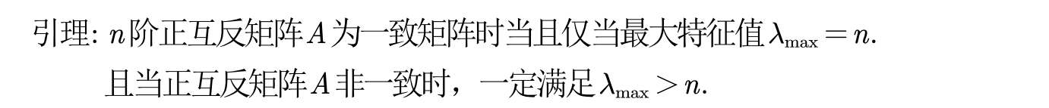
Reference
Reference: QingFeng mathematical model

Slide 14
Consistency test
Step 1: Calculate the consistency indicator CI
Step 2: Find the corresponding average random consistency indicator RI
n | 1 | 2 | 3 | 4 | 5 | 6 | 7 | 8 | 9 | 10 | 11 | 12 | 13 | 14 | 15
RI | 0 | 0 | 0.52 | 0.89 | 1.12 | 1.26 | 1.36 | 1.41 | 1.46 | 1.49 | 1.52 | 1.54 | 1.56 | 1.58 | 1.59
Step 3: Calculate the consistency ratio CR
If CR < 0.1, the consistency of the judgment matrix is acceptable; otherwise, the judgment matrix needs to be corrected.

Slide 15
Consistency test
Unfortunately, the CR > 0.1. How can we deal with it?
1 | 2 | 5
1/2 | 1 | 2
1/5 | 1/2 | 1
1 | 2 | 4
1/2 | 1 | 2
1/4 | 1/2 | 1
It's easy, just transform the judgment matrix into a consistency matrix as much as possible.

Slide 16
Calculate weight
How are the weights calculated for the consistency matrix?
C1 | P1 | P2 | P3
P1 | 1 | 2 | 4
P2 | 1/2 | 1 | 2
P3 | 1/4 | 1/2 | 1
P1 = 1 /(1+0.5+0.25) P2 = 0.5 /(1+0.5+0.25) P3 = 0.25 /(1+0.5+0.25) Weights must be normalized!

Slide 17
Calculate weight
How the judgment matrix calculates the weights?
C1 | P1 | P2 | P3
P1 | 1 | 2 | 5
P2 | 1/2 | 1 | 2
P3 | 1/5 | 1/2 | 1
The first column P1 = 1 /(1+0.5+0.2)= 0.5882
P2 = 0.5 /(1+0.5+0.2)= 0.2941
P3 = 0.2 /(1+0.5+0.2)= 0.1177
The second column
P1 = 2 /(2+1+0.5)= 0.5714
P2 = 1 /(2+1+0.5)= 0.2857
P3 = 0.5 /(2+1+0.5)= 0.1429
C1 | P1 | P2 | P3
P1 | 0.5882 | 0.5714 | 0.625
P2 | 0.2941 | 0.2857 | 0.25
P3 | 0.1177 | 0.1429 | 0.125
The third column P1 = 5 /(5+2+1)= 0.625
P2 = 2 /(5+2+1)= 0.25
P3 = 1 /(5+2+1)= 0.125

Slide 18
Calculate weight
Method 1. Arithmetic averaging for weights (0.5882+0.5714+0.625)/3
C1 | P1 | P2 | P3
P1 | 0.5882 | 0.5714 | 0.625
P2 | 0.2941 | 0.2857 | 0.25
P3 | 0.1177 | 0.1429 | 0.125
Method 2. Geometric averaging for weights (0.5882*0.5714*0.625) ^ (1/3)

Slide 19
Calculate weight
Method 3. Eigenvalue method for finding weights
If the consistency of our judgment matrix is acceptable, then we can follow the method of finding the weights of the consistent matrix.
Step 1: Find the largest eigenvalue of matrix A and its corresponding eigenvector.
Step 2: Normalize the eigenvectors to get our weights.

